Slide 1
Research committee
Nov 2016

Slide 2
Members of the committee
Prof Rantloane
Dr Spijkerman
Dr Khobo-Mpe
Dr Dippenaar
Dr Alberts

Slide 3
Functions of the committee
Assess protocols i.t.o feasibility
Develop database of research
Assess funding applications
Co-supervision (increase capacity)
Compile a research info pack
Ensure registrars start with projects timeously
Coordinate Friday afternoon research activities

Slide 4
Getting started
Idea
Approach
a consultant
Prof Rantloane
assesses idea
Prof Rantloane ->
supervisor
Hettie captures
working title
Student & supervisor:
- Sign agreement
- Develop protocol
Student & supervisor present protocol to committee
MMed
committee
Ethics
committee

Slide 5
NB info/documents:
Scientific writing guidelines
Protocol template
Protocol assessment template
Referencing: Vancouver
Refworks/Endnote info
Supervisor agreement
MMed/ethics committee dates
TNM 800
Librarian contact details
Funding opportunities
Originality report - Turnitin

Slide 6
Protocol template
www.up.ac.za ➔
Schools and depts ➔
School of Medicine ➔
Research ➔
Postgraduate students ➔
Mmed protocol Committee ➔
Protocol template

Slide 7
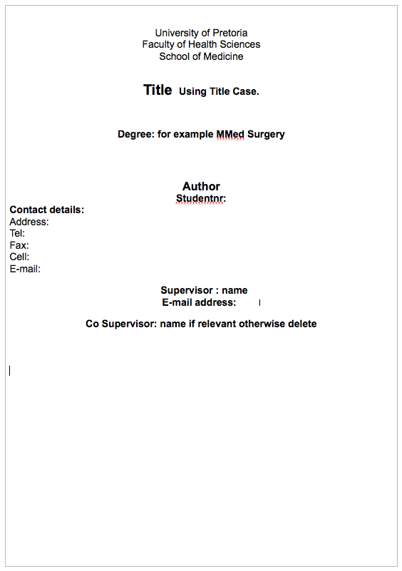

Slide 8
Assessment template
www.up.ac.za ➔
Schools and depts ➔
School of Medicine ➔
Research ➔
Postgraduate students ➔
Mmed protocol Committee ➔
Critical appraisal form

Slide 9
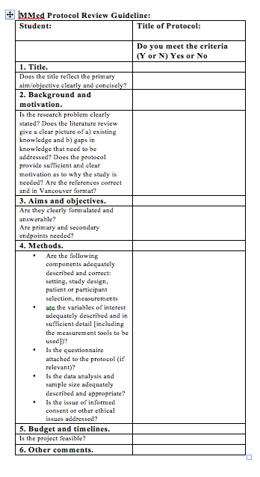

Slide 10
Referencing:
1. Vancouver style:
www.up.ac.za -> library –> Services -> Referencing –> Vancouver
2. Refworks/Endnote:
www.up.ac.za -> library –> Services -> Referencing –> Refworks/Endnote tutorials

Slide 11
Supervisor agreement
Google:
University of Pretoria memorandum of agreement supervisor
OR
Contact Hettie (hettie.steyn@up.ac.za)

Slide 12
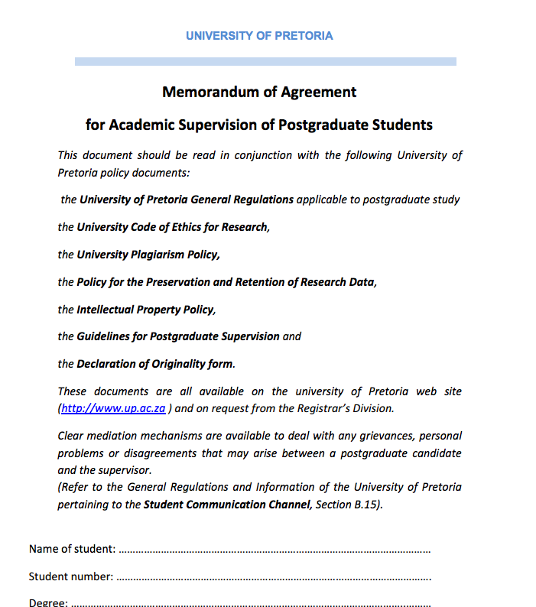

Slide 13
MMed committee dates
www.up.ac.za ➔
Schools and depts ➔
School of Medicine ➔
Research ➔
Postgraduate students ➔
MMed protocol Committee ➔
Dates

Slide 14
Ethics committee dates
www.up.ac.za ➔
Faculties➔
Faculty of Health Sciences➔
Research ➔
Research ethics ➔
First application➔
Submission dates

Slide 15
TNM 800
www.up.ac.za ➔ Faculties➔Faculty of Health Sciences➔Academic Programmes➔TNM 800
You will be assigned a date
If you choose your own – check leave roster
YOU NEED A DRAFT PROTOCOL UPON REGISTRATION

Slide 16
Librarian
For assistance with literature search and referencing.
Estelle Grobler:
estelle.grobler@up.ac.za
+27 12 354 2613

Slide 17
Funding opportunities
Registrars:
1st line: Jan Pretorius research fund (SASA) –
http://www.sasaweb.com/scholarship/JPRF
2nd line: Dept Anaesthesiology –
Approach dept research committee

Slide 18
Turnitin
= Originality report (checks for plagiarism)
Please contact Research Committee when your final dissertation is ready for submission
Report will be supplied

Slide 19
Your responsibilities
Early initiation of research – follow process
Ethical conduct of research
Driving the process
Write-up
Finish prior to sitting FCA II

Slide 20
Responsibility of supervisor
Guidance – developing idea/protocol/conduct
Availability
Acceptable turn-around time when reviewing provisional work
NOT TO DO THE RESEARCH FOR THE REGISTRAR

