Slide 1
Basic Course in Statistics
Reinhard Tolken

Slide 2
Introduction
What will be covered in this course:
Variables and Constants
Levels of measurement
Samples and Populations
Data Preparation
Data Transformation
Codebook
Statistics (Descriptives, Inferentials (Parametric & Non-Parametric))
Creating a Datafile
Screening & Cleaning of the data
Preliminary Analysis (Including assessing normality)
Looking at advanced statistics

Slide 3
Some basic concepts
Variables and Constants
When we are measuring height or weight these can be seen as variables.
The reason is that their measurement can vary from time to time
When we deal with a quantity or value that does not change it is referred to as a constant for example the speed of light

Slide 4
Variables
Important terms regarding variables:
Independent Variable (A variable thought to be the cause of some effect)
Dependent Variable (A variable thought to be affected by changes in the independent variable)
Predictor Variable (A variable thought to predict an outcome – another term for independent variable)
Outcome Variable (A variable thought to change as a function of changes in a predictor variable – synonymous with dependent variable)

Slide 5
Variables
Continuous VS Discrete Variables
Continuous Variable (Can take any value in a defined range – weight or height as an example)
Discrete Variable (These variables can only take certain values – example in a race 1st, 2nd and 3rd place can be awarded not 3.25rd or assigning 1 for males and 2 for females there isn’t a 1.5 category. Discrete Variables also known as Categorical Variables)

Slide 6
Level of Measurement
Nominal (Indicate that there is a difference between categories of objects, persons or characteristics – numbers are used here as labels)
Cannot do any maths (operations or relations)
Example:
Gender (1 = Male, 2 = Female)
Psychopathology (1 = Schizophrenic, 2 = Manic Depressive, 3 = Neurotic)

Slide 7
Level of Measurement
Ordinal (Variables indicate categories that are both different from each other and ranked in terms of the attribute.)
May perform math relations <>, but not math operations (+,-,*,/)
Example
Race winners 1st, 2nd and 3rd
This is an ordinal scale as we don’t know how far the 2nd winner was from the 1st
Intervals between numbers are meaningless and therefor no maths

Slide 8
Level of Measurement
Interval (These variables are true quantitative measures – the difference/distance between any 2 scores is an accurate reflection of the difference in the amount of an attribute that the two objects have
Example
Temperature, IQ scores, scores of attitude, knowledge tests
Mathematical relations = <> and math operations +,- can be done

Slide 9
Level of Measurement
Ratio (These variables have all the properties of Interval scales but because they have the true zero value *, / can also be done
Example
Exam marks – 0%-100%
Age – a 40 years old person is twice the age of a 20 year old
Time, length and weight other examples

Slide 10
Samples and Populations
Population – is an entire collection of elements or individuals
Example – Want to know the average income of all South Africans (The bridge example)
Sample – Because it will be physically impossible to collect this data throughout SA, a representative sample of the population should be drawn then to refer the answer back to the population.

Slide 11
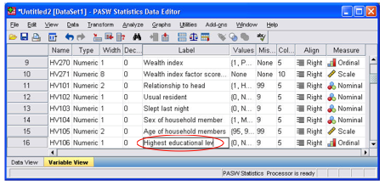
Data Preparation

Slide 12
Data Preparation
Before any STATS are done:
In the first instance one needs to have a look at the accuracy of the data
The responses readable?
All important questions answered?
The responses complete?
All relevant contextual information included (e.g., data, time, place, fieldworker)?
Secondly transferring the data to a computer programme

Slide 13
Data Preparation
Programmes that can be utilized:
Microsoft Excel
Microsoft Access
SPSS
SAS
Get a codebook going – write all your codes that you assign to your measure in the book, e.g. the defining and labeling of variables and assigning numbers to each possible response.

Slide 14
Data Preparation
variable name
variable description
variable format (number, data, text)
instrument/method of collection
date collected
respondent or group
variable location
notes (Trochim, 2006)

Slide 15
Data Transformation
When the data have been entered into the appropriate programme then the transformation of the data can begin:
This step could include screening for missing values (thus fields the respondents left out) in some programmes like SPSS defining these values as missing is a must.
Item reversals – Likert scales
Collapsing variables (Strongly agree, Agree – recoded into 1 single variable called Agree)

Slide 16
Example of a Codebook
Variable (SPSS Variable Name)
Coding Instruction
Identification Number (ID)
Sex (Sex)
Marital Status (Marital)
Scale Question Items 1 to 6 (op1 - op6)
Number assigned to each survey
1 = Males
2 = Females
1 = Single
2 = Married
3 = Divorced
1 = Strongly disagree – 5 = Strongly Agree, 6 = Do Not Know

Slide 17
STATISTICS

Slide 18
STATISTICS
The science of describing and interpreting numerical data in accordance with the theory of probability, and the application of analytical techniques such as significance tests, determination of confidence intervals and parameter estimation to such data. The two major branches of statistics are descriptive statistics and inferential statistics. (Colman, 2001)

Slide 19
STATISTICS
Descriptive Statistics:
Summaries of numerical data that make them more easily interpretable, including especially the mean, variance, standard deviation, range, standard error of the mean, kurtosis and skewness of a set of scores.

Slide 20
STATISTICS
Inferential Statistics:
Techniques for inferring conclusions about populations on the basis of data from samples. The major objective is usually to decide whether the results of the research are statistically significant.
There are 2 routes one can take with regards to inferential statistics
Parametric and Non-Parametric Statistics

Slide 21
STATISTICS
Parametric Statistics
Most statistical techniques based on this
There are also a couple of assumptions that need to be adhered to:
Normally Distributed Data
Homogeneity of Variance
Interval Data
Independence

Slide 22
STATISTICS
Non-Parametric Statistics
Do not have stringent requirements and do not make assumptions about the underlying population distribution
Disadvantage:
Less sensitive than the parametric statistics and may fail to detect differences between groups that actually do exist
Always try and use Parametric Stats – but can be used for Nominal and Ordinal data and also when you have a small sample

Slide 23
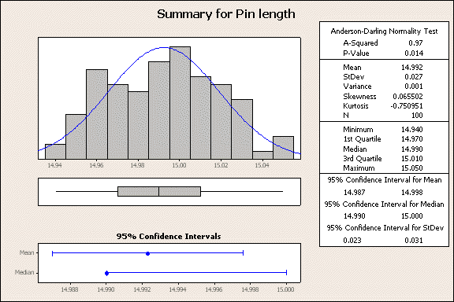
Descriptive Statistics

Slide 24
Descriptive Statistics
Once the data have been prepared and transformed (thus you are sure that there is no errors in your data) one could then go on and do statistics on the available data.

Slide 25
Descriptive Statistics
There are a number of uses of descriptive stats:
Describing the characteristics of the sample
Checking your variables for any violation of the assumptions underlying the statistical techniques
To address specific research questions (Pallant, 2007)

Slide 26
Descriptive Statistics
To get descriptive statistics for categorical variables (males – females) frequencies should be used, this will tell you how many gave a response in these categories.
To get descriptive statistics for continuous variables (age) it is better to use descriptive analysis which will then provide a summery of the variables (mean, median and the mode)

Slide 27
Descriptive Statistics
Univariate analysis is the simplest form of quantitative (statistical) analysis. The analysis is carried out with the description of a single variable in terms of the applicable unit of analysis. For example, if the variable "age" was the subject of the analysis, the researcher would look at how many subjects fall into given age attribute categories.
Univariate analysis contrasts with bivariate analysis – the analysis of two variables simultaneously – or multivariable analysis – the analysis of multiple variables simultaneously. Univariate analysis is commonly used in the first, descriptive stages of research, before being supplemented by more advanced, inferential bivariate or multivariate analysis.

Slide 28
Descriptive Statistics
Univariate analysis:
Involves the analysis of one variable across cases one variable at a time
3 major characteristics
Distribution
Central Tendency
Dispersion

Slide 29
Descriptive Statistics – Univariate Analysis
The Distribution:
The distribution is a summary of the frequency of individual values or ranges of values for a variable
E.g. The percentage distribution of students by their year of study 1st years 2nd years etc.
Or age / race / gender / income percentage wise

Slide 30
Descriptive Statistics – Univariate Analysis

Slide 31
Descriptive Statistics – Univariate Analysis
Central Tendency
The middle or typical value of any probability distribution or set of scores usually measured by the mean, mode and median
Mean (Average) the most commonly used method of describing the central tendency – sum the values divide by the amount of instances.
Median (middle score) the score found in the exact middle
1, 2, 3, 4, 5 median is 3

Slide 32
Descriptive Statistics – Univariate Analysis
Mode (frequently occur) the most frequently occurring score – scores arranged in order count the scores and the most frequently occurring score is the mode.
1,2,2,2,3,4,4,4,4,5,6 mode is 4

Slide 33
Descriptive Statistics – Univariate Analysis
Dispersion – refer to the spread of values around the central tendency.
Range – take highest value and subtract it by the lowest value – 42- 10 = 32
Standard Deviation – is a more accurate and detailed estimate of dispersion because an outlier can greatly amplify the range

Slide 34
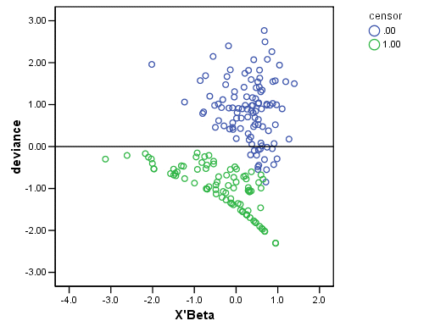
Descriptive Statistics – Univariate Analysis
Deviance (Back to bridge analogy)

Slide 35
Descriptive Statistics – Univariate Analysis
Degrees of freedom
Sport example

Slide 36
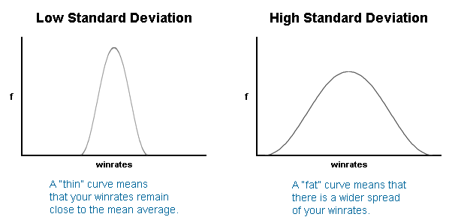
Descriptive Statistics – Univariate Analysis
Standard deviation

Slide 37
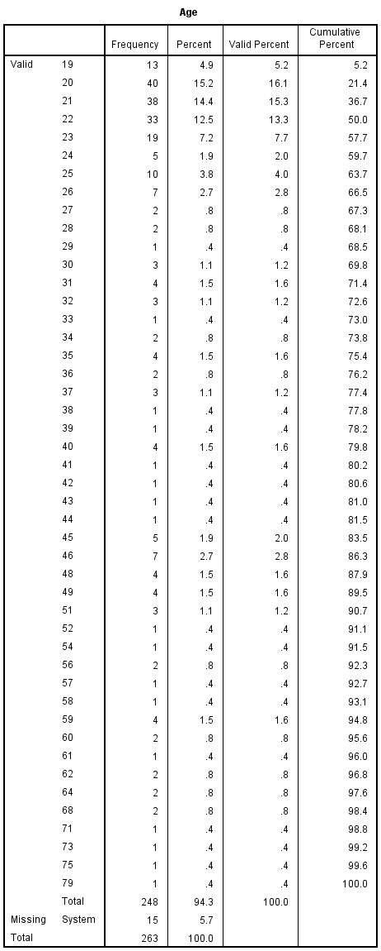
Descriptive Statistics – Univariate Analysis

Slide 38
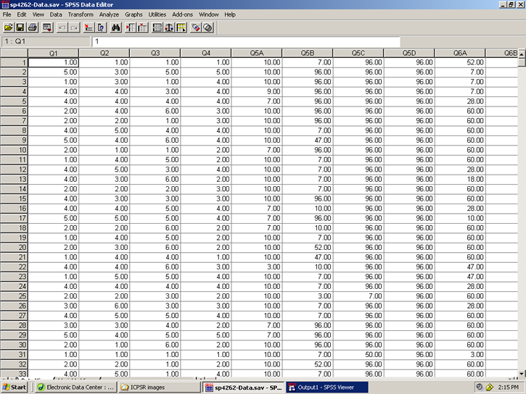
Creating a Datafile

Slide 39
Creating a Datafile
Step 1: Check and modify the options in SPSS to display the output that is produced
Step 2: Structure the datafile by defining the variables (Will demonstrate in SPSS)
Step 3: Enter the data from each participant (Will demonstrate in SPSS)

Slide 40
Screening and Cleaning of the data
Human error can slip in when capturing the data in SPSS, for example typing 35 instead of 3 – this may distort and negatively influence the outcome
Step1: Checking for errors
Step 2: Finding and correcting that error in the file

Slide 41
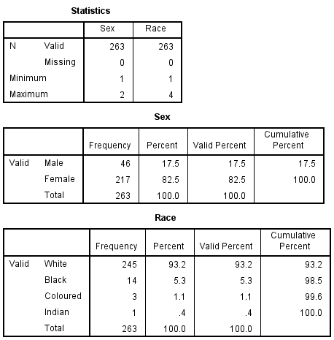
Screening and Cleaning of the data
Step1: Checking for errors
Very important to correct any errors
For Categorical Variables – Frequencies should be used (Sex, marital status, education level)

Slide 42
Screening and Cleaning of the data
Step1: Checking for errors
Very important to correct any errors
For Continuous Variables – Descriptives should be used (Age)

Slide 43
Screening and Cleaning of the data
Step 2: Finding and correcting that error in the file
There are 2 methods in correcting errors
Method 1: In the Data View Tab select the column and sort Ascending or Descending
Method 2: Go to the relevant column highlight it, go to Edit and click on the Find function and correct the particular instance

Slide 44
Preliminary Analysis – Descriptive Statistics - Categorical
This is more or less the same as done in the screening part of analysing the data but how do one write up the findings?
From the above we know there are 46 males (17.5 per cent) and 217 females (82.5 per cent)

Slide 45
Preliminary Analysis – Descriptive Statistics - Continuous
The variable age we have information from 248 respondents, ranging in age from 19 to 79 years, with a mean of 29.69 and a standard deviation of 13.65
Descriptive provide info concerning the distribution of the scores on continuous var (skewness and kurtosis)
Skewness indicates the symmetry of the distribution – Positive clusters to the left side, negative clusters to the right side
Kurtosis indicates the “peakedness” of the distribution – Positive then it is peaked, below 0 then it is relatively flat

Slide 46
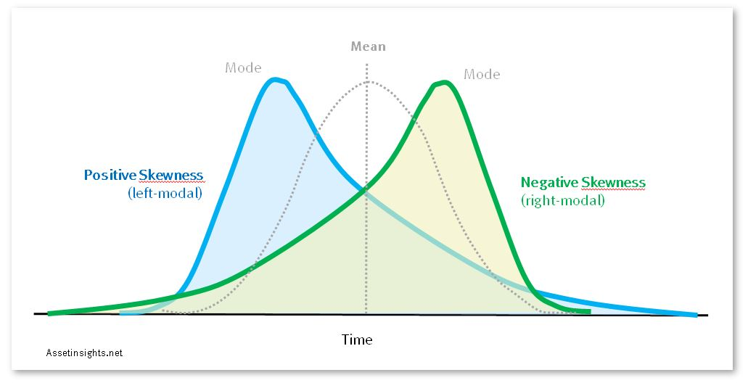
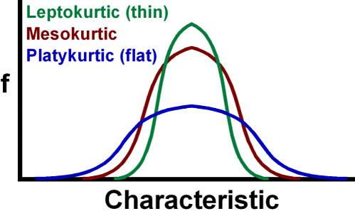
Preliminary Analysis – Descriptive Statistics – Skewness / Kurtosis

Slide 47
Preliminary Analysis – Descriptive Statistics – Missing Data
Missing data can have a great influence on the statistical results, there are however a couple of things on can do to minimize it
With any analysis being run you can decide if you want to include or exclude missing data via the OPTIONS button these include:
Exclude cases listwise – this option will only included cases if they have full data on all of the variables listed in the Variables box, this can limit the sample size drastically
Exclude cases pairwise – excludes only the case (person) if the data is missing for that particular analysis but would still be included for other analysis
Replace with mean – this option calculates the mean value of the variables and gives ever case this value – DO NOT USE THIS OPTION

Slide 48
Preliminary Analysis – Assessing Normality
Many of the statistical techniques assume that the distribution of scores on the dependent variable is “normal” – Normal is used to describe a symmetrical, bell-shaped curve
A non-significant (Sig value of .05) indicates normality, Sig value of .000 suggest that assumption of normality has been violated – but this is common in large samples
Statistical techniques are sensitive to Outliers

Slide 49
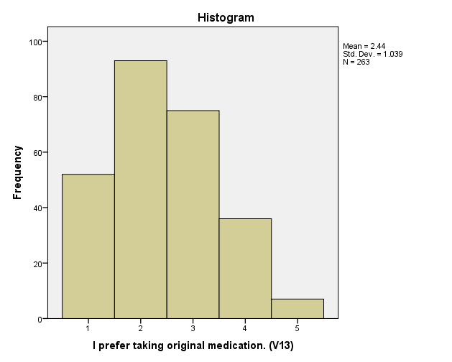
Preliminary Analysis – Assessing Normality

Slide 50
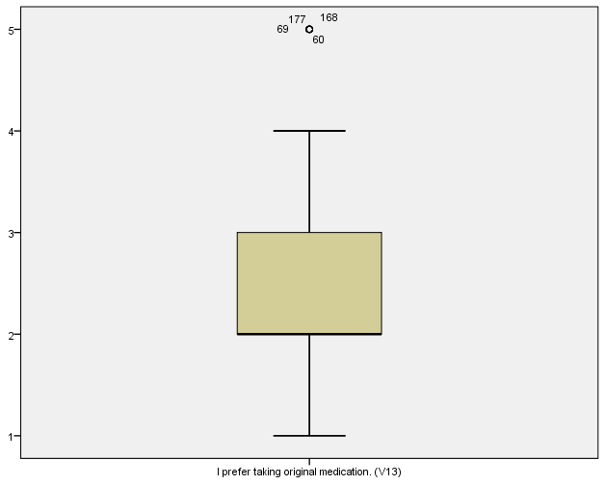
Preliminary Analysis – Assessing Normality - boxplot

Slide 51
Different Statistical Techniques
Exploring Relationships: Looking at the strength of the relationship between variables
Correlation: Using Pearson or Spearman Correlation to explore the strength of the relationship between 2 continuous variables. This gives the indication of the direction (pos / neg) and the strength of the relationship. A pos correlation indicate – as one increase the other increase as well. Neg correlation one increase the other decrease.

Slide 52
Different Statistical Techniques
Partial Correlation
Is an extension of Pearson correlation. Confounding variables can be controlled - removing the variable (e.g. socially desirable responses) to get a more accurate view of the relationship between the 2 variables investigated.

Slide 53
Different Statistical Techniques
Multiple Regression
A more sophisticated extension of correlation
Used when you want to explore the predictive ability of a set of independent variables on a continuous dependant variable.

Slide 54
Different Statistical Techniques
Factor Analysis
Factor analysis allows one to condense a large amount of variables or scale items (questions in a questionnaire) to a smaller more manageable set of factors.
This is done by summarising the underlying pattern of correlations and looking for groups of closely related items.
Normally used to identify underlying structures when scales and measures are being developed.

Slide 55
Different Statistical Techniques
Other techniques include:
Discriminant function analysis – explore predictive ability of a set of independent variables on one categorical dependent measure. Dependent variable has a clear criterion – passed/failed etc.
Canonical correlation – when one wants to analyse the relationship between 2 sets of variables (a variety demographic variables relate to a measure of wellbeing and adjustment)

Slide 56
Different Statistical Techniques
Structural equation modelling
Sophisticated technique that allows one to test various models concerning the inter-relationships among a set of variables. Based on multiple regression and factor analysis – allows one to evaluate the importance of each independent variable in the model and then test the fit of the model to the data

Slide 57
Different Statistical Techniques – Between Groups
T-tests
Are used when one has 2 groups (males & females) or experimental (before and after groups)
2 Main types of t-tests
Paired samples t-test (repeated measures)
Independent samples t-test
Non-parametric alternative – Mann-Whitney U test and Wilcoxon Signed Rank test

Slide 58
Independent-samples T-test
For example: Is there a significant difference in the mean self-esteem scores for males and females?
Will tell you whether there is a statistically significant difference in the mean score for the 2 groups

Slide 59
Different Statistical Techniques – Between Groups
One-way analysis of variance (ANOVA)
Similar to the t-test but used when there are more than 2 groups and you wish to compare their mean scores on a continuous variable
Called one way – looking at the impact of one independent variable on the dependent variable
Will let you know whether the groups differ but will not tell you where the significant difference is

Slide 60
Different Statistical Techniques – Between Groups
There are 2 types of one way ANOVAs
Repeated measures ANOVA (same people on more than 2 occasions)
Between-groups (independent samples) where 2 or more groups means are compared
Non parametric alternative – Kruskal-Wallis test and Friedman test

Slide 61
Different Statistical Techniques – Between Groups
Two-way analysis of variance
Allow you to test the impact of two independent variables on one dependent variable.
Advantage – allows to test for interaction effect – the effect of one independent variable is influenced by another.
Also tests for main effects – the overall main effect of each independent variable (sex, age)

Slide 62
Different Statistical Techniques – Between Groups
There are 2 two-way ANOVAs
Between groups ANOVA (when groups are different)
Repeated measures ANOVA (Same people tested on more than one time)
This design can be mixed – Mixed Between-Within Design (Split Plot)

Slide 63
Different Statistical Techniques – Between Groups
Multivariate analysis of variance (MANOVA)
Used when you want to compare the groups on a number of different (related) dependent variables.
E.g. anxiety, depression, physical symptoms.
Can be used with a one-way, two-way or higher factorial designs where one, two or more independent variables are involved

Slide 64
MANOVA
Why not do couple of ANOVA’s for each dependent variable? – Well running lots of analysis might produce significant results where in fact there may not be any significant results between the groups (Called inflated Type1 error)
Has a number of additional assumption that needs to be met.

Slide 65
MANOVA
Example: Do males and females differ in their mental health? Is there a difference in the adjustment between males and females with regards to their positive and negative mood states and their levels of perceived stress?
One-way ANOVA
One categorical independent var (e.g. sex)
Two or more continuous var (e.g. perceived stress, positive affect)

Slide 66
Different Statistical Techniques – Between Groups
Analysis of covariance (ANCOVA)
Used when you want to control for possible effects of additional confounding variables
Useful when you suspect that the groups differ on some variable that may influence the effect that the independent variable have on the dependent variable.
To be sure that it is the independent variable that influences ANCOVA statistically removes the effects of the covariate – can be done one-way, two way or multiple methods

Slide 67
Decisions-Decisions
According to Pallant (2007) there are a variety of choices one can make with regards to choosing the right statistical technique to analyse one’s data.
These can include the type of questions one wants to address, items and scaling included in the questionnaire, nature of the data etc.

Slide 68
Decisions-Decisions
1 What questions do you want to address?
Get a list in order of questions you would like answers for out of the research conducted – different questions would entail different statistical techniques
Also depends on the type of data you collected and the number of questions

Slide 69
Decisions-Decisions
2 Question and scale items
The type of questions asked and the type of items utilized will impact the statistical techniques used
Thus it would be wise to think about the stats that will be used in the study when still in the initial beginning or designing stage
For example – the way in which you collect age from the participants. (under 30/above 30) or indicate your age.

Slide 70
Decisions-Decisions
3 Identify the nature of each variable
Identify whether each of your variables is an independent variable or dependent variable – not from the data but from your understanding of the topic area, theories and prior research
Level of measurement is also important to know for each of the variables, different stats are needed for categorical and continuous variables

Slide 71
Decisions-Decisions
Variables:
Categorical (nominal data e.g. sex – male/female)
Ordinal (ranking – 1st, 2nd, 3rd )
Continuous (interval level, age in years or scores on a likert scale for example)
Can collapse continuous variables into smaller number of categories

Slide 72
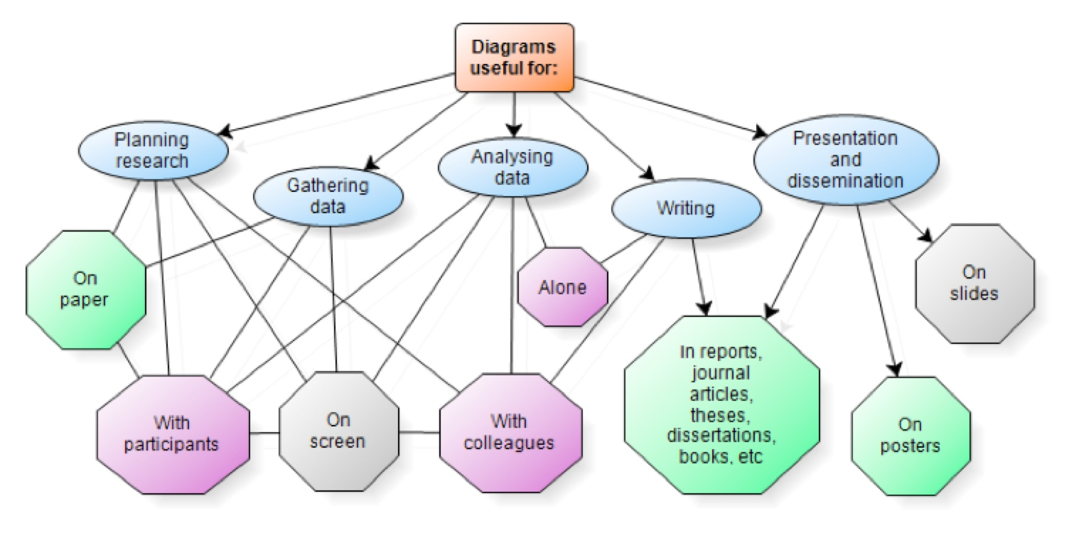
Decisions-Decisions
4 Draw diagrams for the research questions

Slide 73
Decisions-Decisions
5 Decide whether parametric or non-parametric statistics will be utilized
Statistical techniques are divided into two main categories – parametric and non-parametric
Parametric stats – the more powerful stats but the assumptions are more strict for example the populations scores are assumed to be normally distributed – each technique have their own added assumptions

Slide 74
Decisions-Decisions
Non-parametric – this type of stats are not that strict with their assumptions as is the case of the parametric stats. They have assumptions however.
If I do not meet the assumptions what then
There are options one can take
You can use the parametric stats anyway – hope that it does not invalidate the findings
Manipulate the data to be a normal distribution
Use non-parametric stats – but not as powerful as parametric stats

Slide 75
Decisions-Decisions
6 Final decision
Once all of the above have been looked at you are confident about how to precede further then you may go ahead with the analysis.
Also read up as much as you can about the statistical methods as possible, would give you a clear idea how to analyze and interpret the output

Slide 76
Bibliography
Pallant, J. (2010) SPSS Survival Manual (4th ed.). Open University Press:New York
Tredoux, C., & Durheim, K. (2005) Numbers, Hypotheses & Conclusions: A course in statistics for the social sciences. UCT Press: Cape Town
Field, A (2009) Discovering Statistics Using SPSS (3rd ed.), SAGE: London
Evans, R.E. (2010) Statistics, Data Analysis, and Decision Modelling (4th ed.), Pearson:New Jersey

